Slide 1
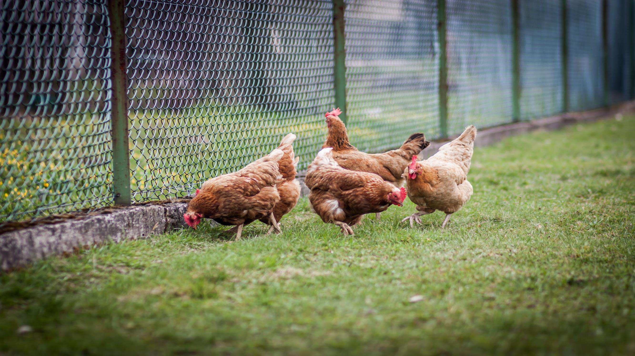

POULTREX
GLA-EC0
A Promising Solution to the Global Poultry Industry's Salmonella & other Microbial Problems
WWW.GLA-ECO.COM

Slide 2
ABOUT GLA-ECO
GLA-ECO is at the forefront of innovation as a leading developer of
environmentally friendly and value-driven pesticide formulations.
With a strong commitment to sustainability, GLA-ECO combines cutting -edge technology with ethical practices to provide effective solutions that minimize environmental impact.
With a highly qualified R&D chemistry team and two world known leading
professors, Our green formulations revolutionize pest control while promoting biodiversity and protecting ecosystems.
BACKGROUND
on both the environment and human health.
2

Slide 3
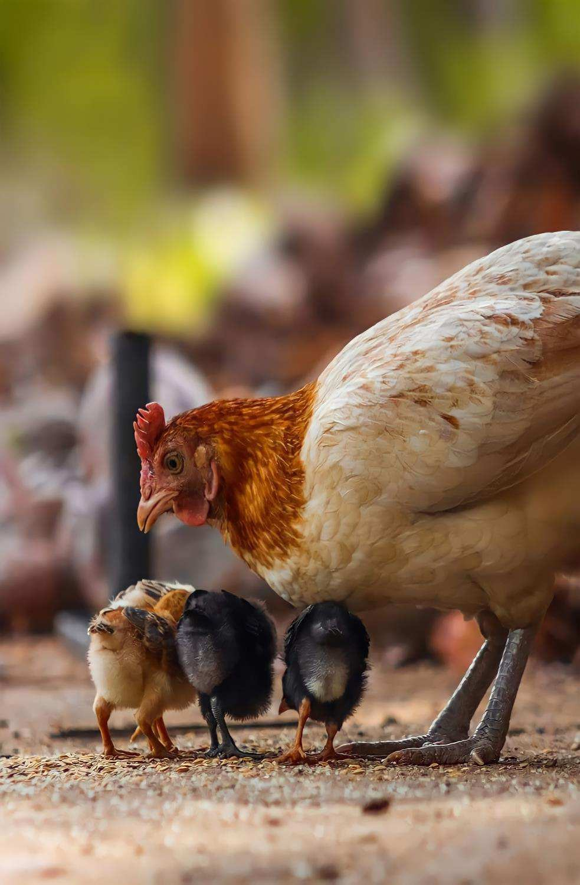
THE PROBLEM
Poultry is a vital food item globally,
but it is often linked to foodborne illnesses.
SALMONELLA IN POULTRY
Include nonmotile serotypes ( S
enterica Pullorum and S enterica
Gallinarum) and motile paratyphoid
Salmonella, with a global presence and have public health implications.
Salmonella, Staphylococcus aureus, and Clostridium perfringens are the
primary agents causing these diseases in chicken and turkey.
USA's National Poultry Improvement Plan has reduced S enterica Pullorum and S enterica Gallinarum infections.
Salmonella poses a significant risk,
leading to high medical costs and lost productivity, making its reduction in
poultry a major challenge for the food industry.
S enterica Arizonae is primarily affects young turkeys through egg
transmission. previously it was classified separately but is now
grouped with paratyphoid Salmonella.
3
https://www.mayoclinic.org/diseases-conditions/salmonella/symptoms-causes/syc-20355329

Slide 4

THE PRODUCT

Slide 5
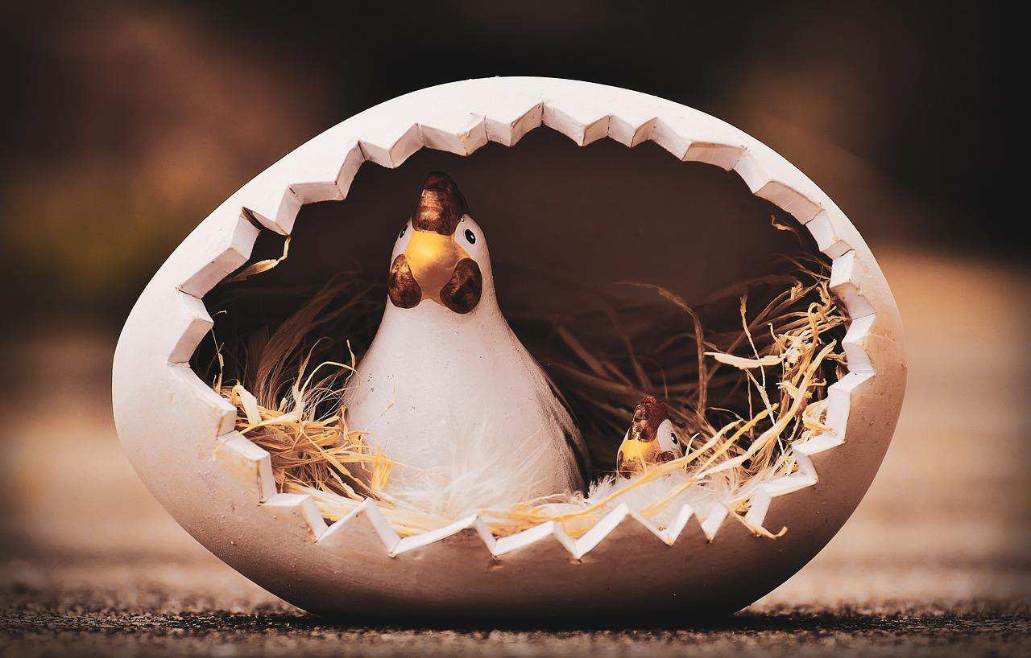
Poultrex
Ecodge introducing a GREEN Innovative toxin-free, emulsifying concentrate solution, for disinfecting animal habitats against pests and diseases, totally safe for animals, humans and the environment

Slide 6
THE SOLUTION - POULTREX
EASY APPLYING
NEW FORMULA
ENVIRONMENTALLY SAFE
AFFORDABLE
Liquid Disinfectant ; Can be applied to the animals' bodies,
without the need to
evacuate;
Safe for humans as well.
Integrated Solution;
Highly effective
against Salmonella; & to disinfect against
a variety of
microorganisms.
non-toxic and non- polluting.
The disinfectant consists of
environmentally and
poultry-friendly ingredients.
No big expenses;
Can be integrated into the existing water
spray system;
Effective in very low
doses (1:1000); Odorless.

Slide 7
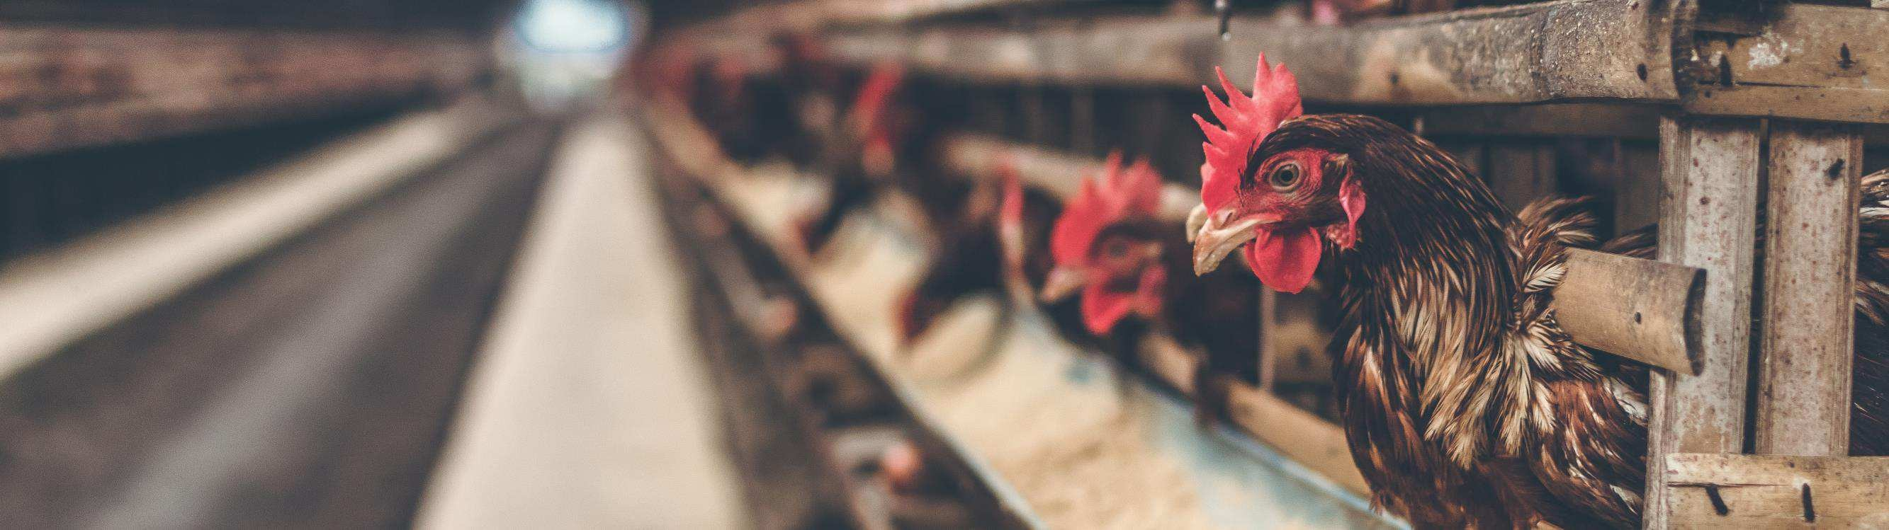
Effortless Poultry Disinfection with Liquid Solution:
No Evacuation Required, Seamless Integration with
PRODUCT BENEFITS
Existing Water Spray System.
Environmentally and Poultry-Friendly Ingredients
Ensure Non-Toxic, Non-Polluting Effectiveness.

Slide 8


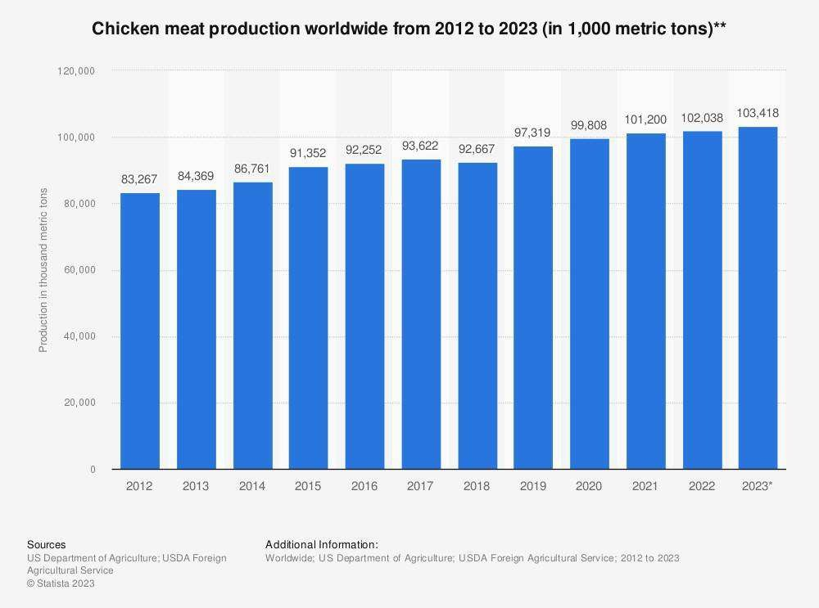
THE GLOBAL MARKET

Slide 9
THE GLOBAL MARKET
CHICKENS WORLDWIDE
CHICKEN FARMING
BROILER MEAT PRODUCTION
The number of chickens worldwide has more than doubled since 1990, with approximately 25.8 billion
chickens in 2021, up from about 13.9 billion chickens in 2000
China leads in egg production with 586 billion eggs in 2021, while the
United States has the largest chicken
population in Iowa.
Poultry has surpassed pork as the most produced type of meat worldwide.
The United States produces the highest volume of broiler meat at 20.4 million metric tons in 2021, followed by China (14.7 million) and Brazil (14.5 million).
Number of Chickens Worldwide (billions)
Broiler Meat 2021 (million metric tons)
30
25
25
20
20
15
15
10
10
5
5
0
0
2021
2000
Brazil
China
US
9

Slide 10
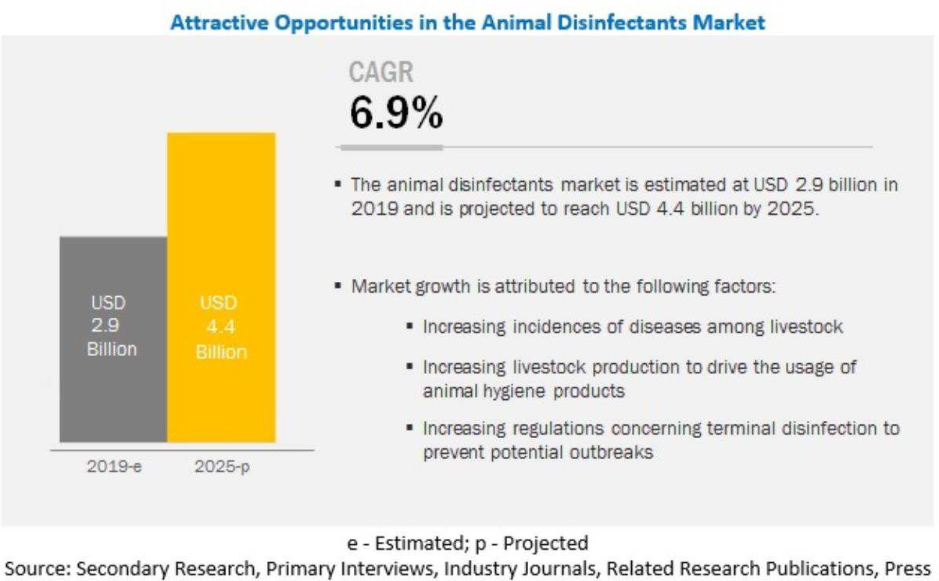
GLOBAL MARKET OF DISINFECTANT
The animal disinfectants market is projected to grow from USD 2.9 billion in 2019 to USD 4.4 billion by 2025, recording a CAGR of 6.9% during the forecast period.
This is attributed to the increasing incidences of livestock diseases, growing awareness about animal hygiene, and mandates pertaining to the disinfection of livestock farms by government organizations.

Slide 11
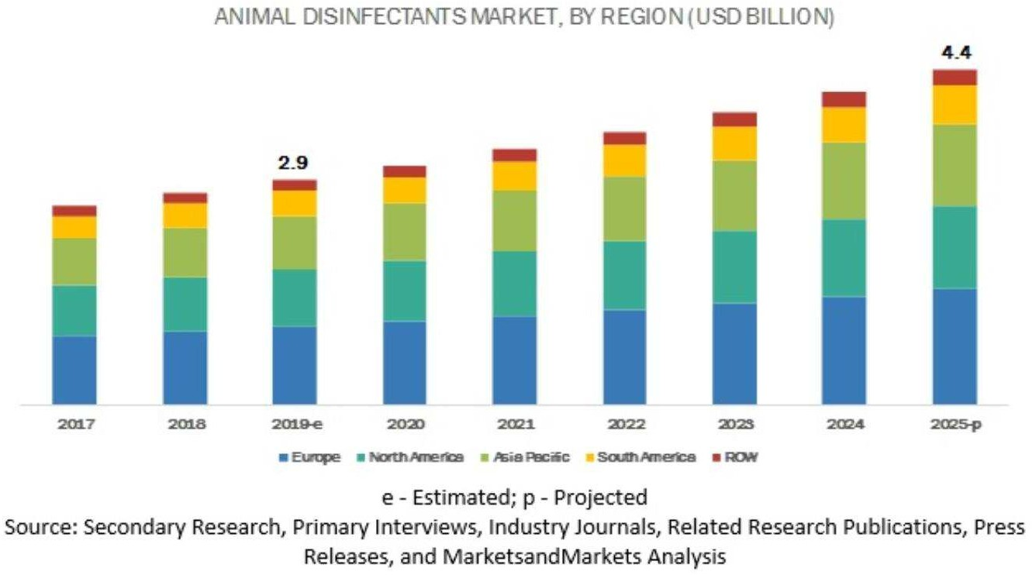
ANIMAL DISINFECTANT MARKET BY REGION (USA BILLION)
Poultrex is not limited to use against salmonella,
it can be used to disinfect against a variety of microorganisms, the
market potential is huge

Slide 12
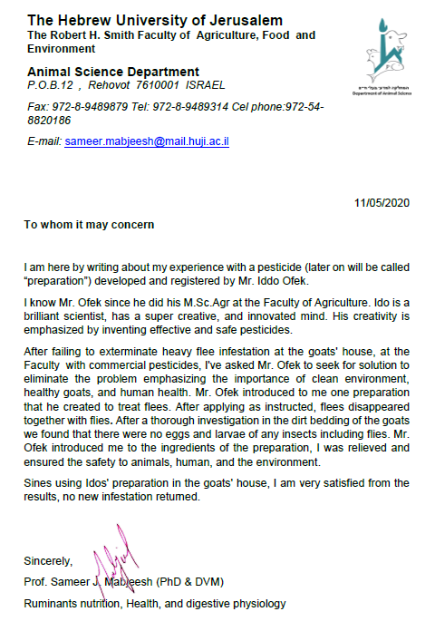


PROFESSIONAL ENDORSEMENTS

Slide 13
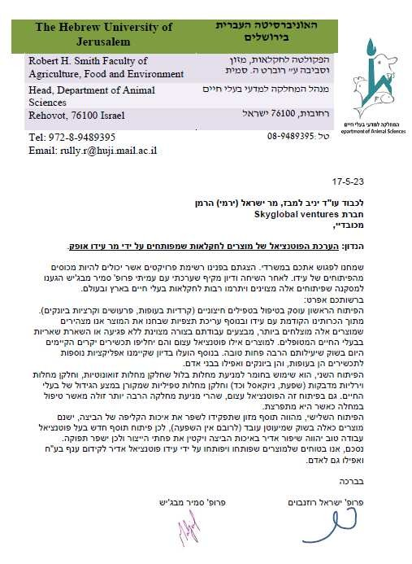

לכבוד מר אופק עידו
GLA-ECO
PROFESSIONAL ENDORSEMENTS

Slide 14
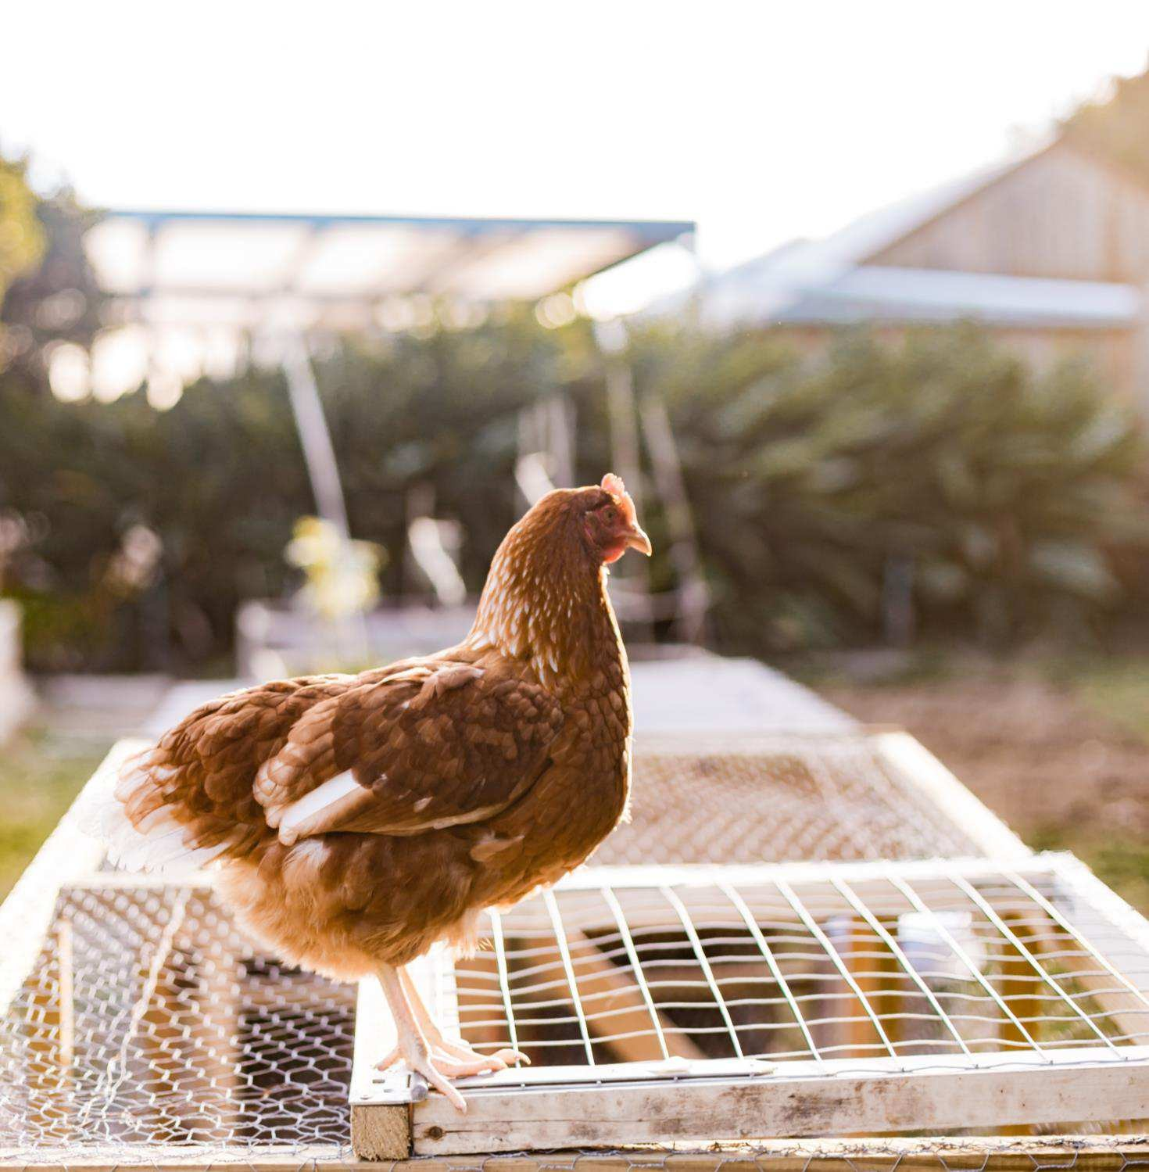
THANK YOU
WWW.GLA-ECO.COM

