Slide 1



Edge eco Technology
Low toxicity & effective active
Ingredient for plant protection
"Creativity is seeing what everyone else has seen, and thinking what no one else has thought"
-Albert Einstein

Slide 2
Who am i?
Eco R&D is lead by Ido Ofek, a pesticide formulation scientist, with a unique out of the box thinking, with 20 years of experience developing, registering, new technologies development and conducting Field trials, with present registered pesticide in the ministry of agriculture in Israel, self developed.
After accumulating many years of R&D, an amazing fungicide was developed: safe, effective and innovative.

Slide 3
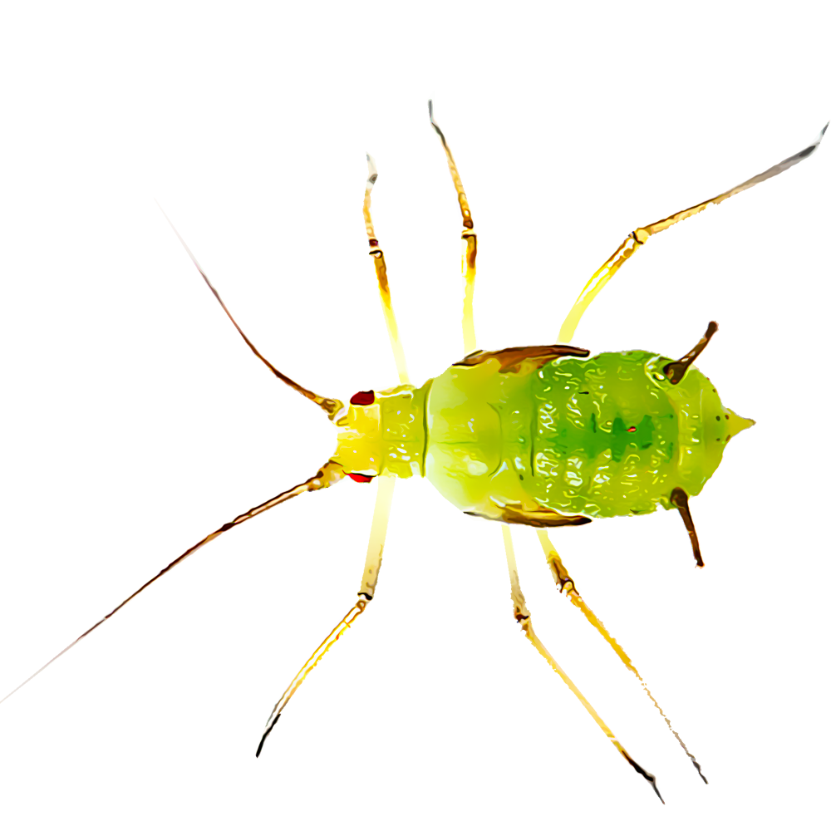

A pesticide for plant protection, with a wide range of activities against harmful arthropods.
No toxins residues.
Contains several active mechanisms against pests, attacking several vulnerabilities. effective in 0.1% concentration.
Biodegradable preparation: does not accumulate in the environment or in groundwater, does not harm biodiversity.
Source of renewable raw materials.
The preparation

Slide 4
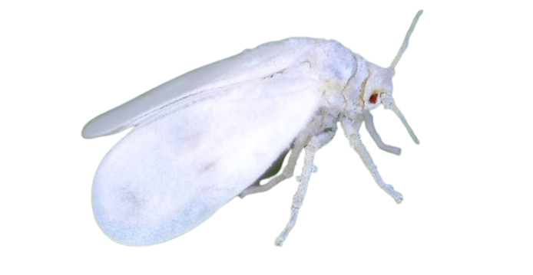
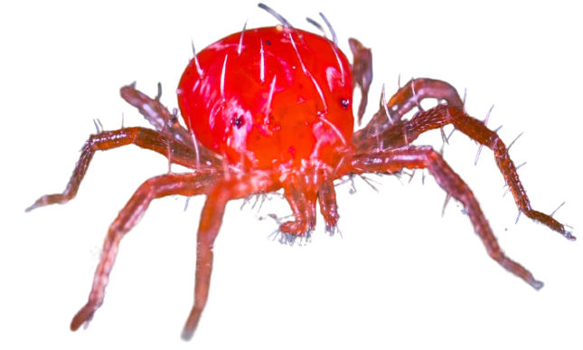
Activity spectrum
Combined activity against harmful arthropods in agriculture:
Insects
Mites

Slide 5
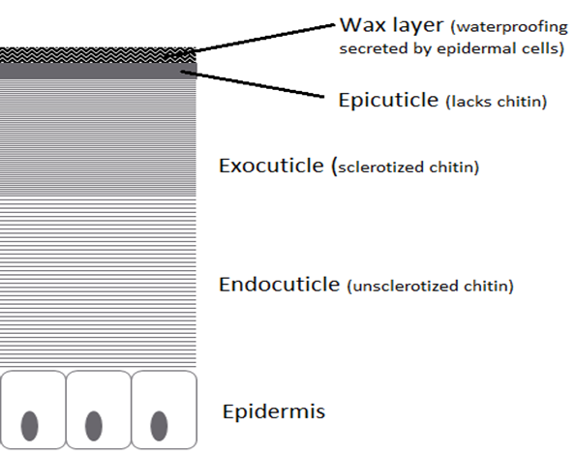
The technology
Exploitation the pest physiology for effective extermination
High affinity of the pesticide to the pest biology, leads to effective pesticides

Slide 6
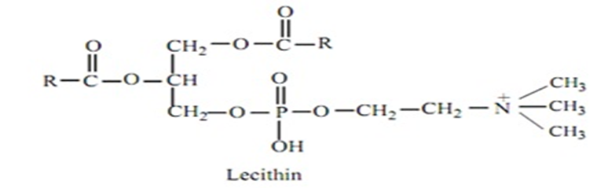
The technology
Lecithin is derived from biological membranes of eukaryotic organisms, it is composed of chemicals, such as phospholipids and choline, characterizes the molecules, which are made up of a polar pole and a nonpolar pole, in that lecithin is used as an adhesive agent, one arm binds to a non polar part of a molecule and one arm binds to a polar part of a molecule.
Lecithin has a high affinity for the cuticle of arthropods and creates an effective coating that adheres well to the insect's body: the nonpolar tails of the lecithin components dissolve in the wax layer that covers the pest cuticle, the polar head dissolves in the active ingredients and thus attaches to the pest.

Slide 7
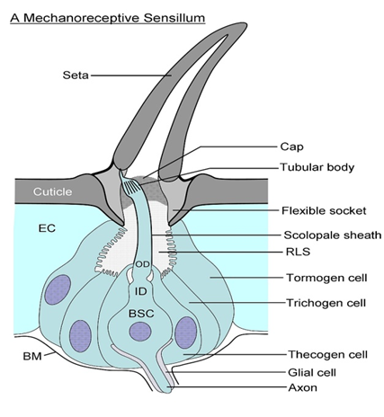
The technology
The high affinity of the pesticide to the insect cuticle, enable blocking its sensory system, the physical separation of the insect between the external and internal environment prevents the insect from sensing external signals of food or pheromones, or responding to changing conditions.
The pesticide even blocks the pests' airways and causes rapid suffocation.

Slide 8
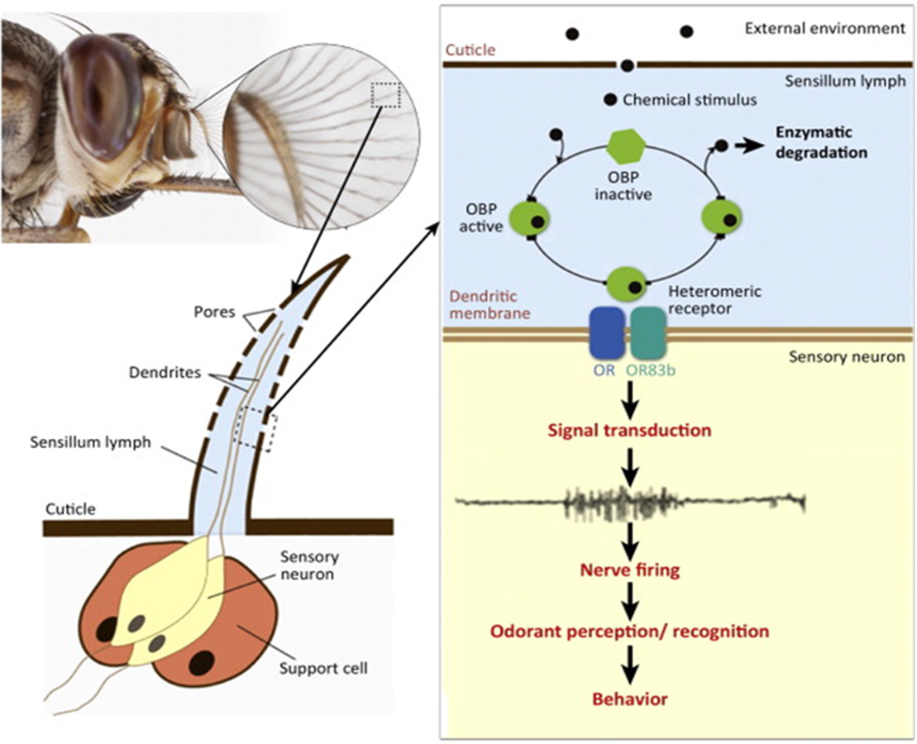
The technology
The diagram shows how the neural impulse passes from exposure to the chemical to the neural response, the sensory hair (left), contains pores through which the chemicals penetrate and come in contact with the receptor system located on the nerve cell branch, the dendrites.

Slide 9
Reactions to form active Ingredient
Formic acid production:
Formic acid is an acidic organic compound with a pKa of 3.75 and its molar mass is 46 g / mol. It is the simplest carboxylic acid.
In the wild, formic acid is found in the bites and insect bites of the bee group (Himnoftra) which includes bees and ants. Ants produce formic acid for defensive and offensive reasons.
Formic acid is also one of the active ingredients in the thorns of most nettle species.
When stung from nettle plant, it is the cause of burning in the skin.

Slide 10
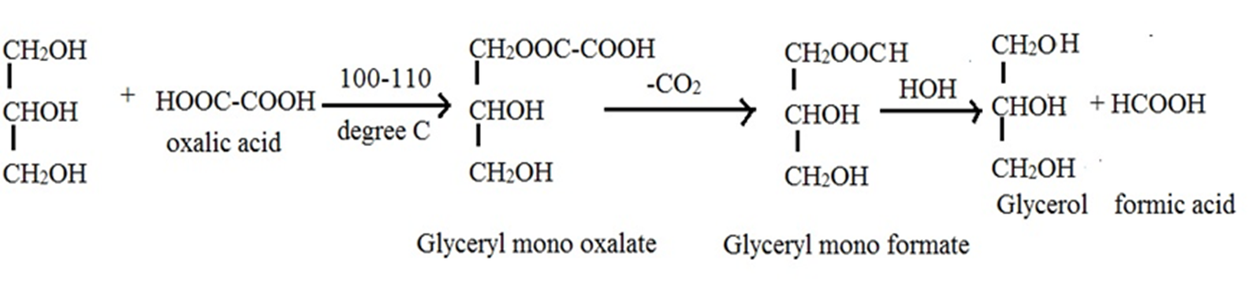
Reactions to form active Ingredient
Ester reaction between oxalic acid and glycerin, which are heated together at 100-110 degrees, in an open equilibrium system, releases formic acid, but the ester formed called glycerol monooxalt is in a closed equilibrium system, the accumulation of products stops the reaction to release formic acid, so glycerol and glycerol Monoformate, after dilution with water and release into the environment, the chemical reaction progresses to form formic acid, which is actually the most active pesticide in the preparation.

Slide 11
Reactions to form active Ingredient
The formic acid formed in the preparation system, causes tiny perforations in the biological membranes in the body and the dislocation of the legs, thereby, causing damage to the balance of fluids and salts in his body a pathological process that leads to the killing of the pest.

Slide 12
existing Agricultural uses of formic acid
Registration # | Product Name | Active Ingredient
2724-406 | ZOECON RF-318 APISTAN STRIP | Fluvalinate (10.25%)
2724-406-62042 | APISTAN ANTI-VARROA MITE STRIPS
61671-3 | FOR-MITE | Formic acid (65.9%)
70950-2 | AVACHEM SUCROSE OCTANOATE [40.0%] | Sucrose octanoate (40%)
73291-1 | API LIFE VAR | Thymol (74.09%), Oil of eucalyptus (16%), Menthol (3.73%)
75710-2 | MITE-AWAY QUICK STRIPS | Formic acid (46.7%)
75710-3 | FORMIC PRO | Formic acid (42.25%)
79671-1 | APIGUARD | Thymol (25%)
83623-2 | HOPGUARD II | Hop beta acids resin (16%)
87243-1 | Apivar | Amitraz (3.33%)
91266-1 | OXALIC ACID DIHYDRATE | Oxalic acid (100%)
91266-1-73291 | OXALIC ACID DIHYDRATE
91266-1-91832 | OXALIC ACID DIHYDRATE
11556-138 | CHECKMITE+ BEE HIVE PEST CONTROL STRIP | Coumaphos (10%)
11556-138-61671 | CHECKMITE+ BEE HIVE PEST CONTROL STRIP
There are several pest control products listed in the EPA that are approved for use against mites and see beehives.
Mites and Varoa are parasites that feed on developing bees, leading to bee mortality and reduced life expectancy of working bees. They also transmit many honeybee viruses.
Colony health may be critically impaired by mites' infestation after infection, if left untreated.

Slide 13
Limitations of use of oxalic acid in agriculture
Limits according to the EPA: It is forbidden to use more than 2.2 kg of oxalic acid lacquer (ten dunams (Ha)).
Based on this data, we will examine whether the material can be used for agricultural pesticides:
data:
Oxalic acid concentration per liter of eco-preparation 136: 20%.
Dilution concentration around 0.1%.
Lacquer spray volume: about 400 liters. (40 liters per hectare)
outcome:
80 grams of oxalic acid per acre, which is 27.5 times less than the legal limit, so the product meets the legal limits of the EPA.

Slide 14
Price estimate per liter of preparation
Estimated cost of raw materials only, without packaging, without production, label, etc., was: $ 2.77 per liter.
Price estimate of raw materials by: https://www.made-in-china.com/
Estimated approximation of the ceiling Price cost includes: $ 5-6 per liter Preparation ready for marketing.

Slide 15
Field trial results for efficacy
Efficacy test results of the pesticide Eco 136, diluted: 0.25%, 0.5%.
Even without statistical analysis the preparation is significantly effective at a concentration of 0.25%.

Slide 16
Field trial results for efficacy
Efficacy test results of the material Eco 136, diluted: 0.05%, 0.1%
The decrease in efficiency in the low concentration indicates an efficiency range around a concentration of 0.1%

Slide 17
Summary
Eco-136 showed good extermination efficacy at concentrations around 0.1%, in a field trial against aphids.
This is a technology that has not been used until now for agricultural pesticides against pests in field crops, so there is an advantage over other methods that use pesticides, due to the high probability of developing cross-resistance of pests to preparations unlike eco-preparation.
Good likelihood of effective IP protection that will allow entry barriers of competing companies.
This is an initial prototype that can be further improved / optimized until a decision is made on a finished product.
Low cost of raw materials and cheap and simple production process (mix and heat).
Future technology for the formulation of a variety of preparations, with low toxicity, without residues of pesticides, cheap and effective.

Slide 18
Business Proposal
The proposal is intended for the purpose of Licensing and marketing of a pesticide.
In order to provide the world with an effective and non-toxic pesticide, we are willing to give 30% of the total ownership of the company for investment of 1.6 million US$.

Slide 19
Procedure and costs
Cost | Duration Month | Stage
 | 3 | Purchase of raw materials and equipment
 | 5 | ​Formulation and stoichiometric planning
 | 6 | Development of a production process in the laboratory
 | 7 | Performing tests: A. In vitro efficiency B. Toxicology survey C. Stability.
 | 6 | Development of an industrial production process​
 | 5 | ​Entering the registration process, writing and filing.
 | 5 | Conducting field trails
 | 5 | Getting sales permit and entering marketing stage
 | 6 | marketing
1,600,000$ | 48 | TOTAL

Slide 20



תודה רבה

