Slide 1


The future of Cosmetic
Crème de Eco

Slide 2
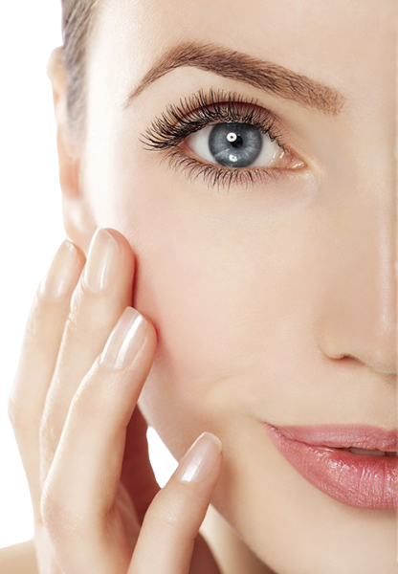
Next generation Cosmetic for wonderful skin
Crème de Eco is assimilating innovations into cosmetic.
By using the best minds of the leading R&D scientists.
Our formulations contains only top quality ingredients, for people that want the best without Compromises.

Slide 3
The science behind
“Crème de Eco”
”
The cream contains high quality ingredients, excluding harmful industrial chemicals which are common in popular cosmetic creams (Parabens, Artificial Fragrance/Parfum, SLS, Toluene, Phthalates, Polyethylene Glycol, Formaldehyde, Oxybenzone, Diethanolamine, Triclosan, and more), by using the best we don’t need artificials.
Sci cream contains:
MSM, Hyaluronic, urea, Monolaurin, vitamins, luxury vegetable oils from cold press, which are proven to reduce wrinkles, improve skin texture, reduce scars, fight skin infections and redness and bring your skin to its optimal state.

Slide 4
Basic information about the actives
Our scientists formulated the optimal combination of natural active ingredients, in order to assemble a cream which is suitable for a wide rang for people with different skin texture & tone, age, gender and skin conditions- all we need is Sci-cream.
Crème de Eco

Slide 5
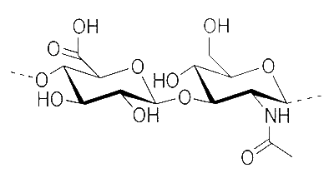
Hyaluronic Acid for skin firming
As we age, our natural hyaluronic acid levels deplete, and that loss of moisture means drier, rougher and lined skin.
By applying the ingredient topically, "its restorative abilities help to boost skin’s moisture content, soothe and prevent moisture loss",
Hyaluronic acid swoops in with the ability to replenish moisture that is crucial to having younger-looking, supple skin.
At the same time, it revitalizes skin’s outer layers so they look and feel softer, smoother, and, glowingly hydrated to instantly improve the appearance of fine lines and wrinkles.
Crème de Eco

Slide 6
MSM
Most MSM benefits stem from the chemical’s role in building nearly every cell in the body. However, it’s also famous for inhibiting the breakdown of collagen, making it a key player in anti-aging treatments.
Due to the sulfur content in MSM and the chemical’s enhancement of antioxidants in the body, MSM has an impressive list of uses. When used topically, MSM has an almost miraculous effect on the skin.
Those dealing with chronic or acute acne may also find relief with a cream containing this powerful ingredient. To explain, MSM limits androgen hormones and helps the skin become more permeable. This means that the toxins leading to blackheads, whiteheads and cysts have a better chance of being released. On top of that, MSM can even help reduce acne scars by boosting collagen growth.

Slide 7
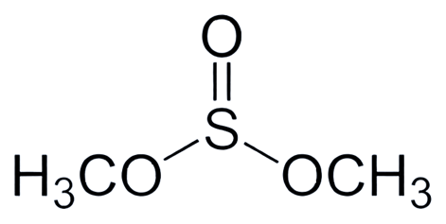
MSM
As great as these MSM benefits are, it does far more for the skin than simply smooth wrinkles and fight acne. It also soothes itching, hydrates dry skin, reduces scar tissue and improves wound healing from cuts and burns.

Slide 8
Caffeine
It Can Help Firm and Tone Aging Skin.
Caffeine may not be the best-known antioxidant, but it has benefits similar to popular antioxidants like vitamins C and E. Additionally, topical caffeine can help boost elasticity and firm the skin, which may promote a more youthful, alert appearance.
Coffee is a natural exfoliator that gently pulls out dead skin cells and impurities from the skin's deepest layers, thus giving you a radiant glow. It is also enriched with antioxidants like phenols, which fight free radical damage on the skin, giving you a look of youth.

Slide 9
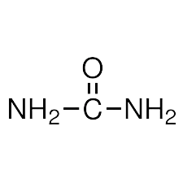
Urea
Urea is an over-the-counter (OTC) emollients, which is a moisturizer to treat or prevent dry, rough, scaly, itchy skin and minor skin irritations (e.g., diaper rash, skin burns from radiation therapy).
Barrier Maintenance-speeding up the renewal of skin cells, which keeps your skin looking healthy and youthful.
Pain Relief-urea shows anesthetic qualities, so you can use it for local pain relief.
Exfoliation-works together with the compounds that build the skin at the molecular level.
Permeability-urea increases your skin’s permeability, allowing other active ingredients to pass through your skin more easily.

Slide 10
Taurine
topical application can help restore skin's youthful appearance by improving the look of wrinkles. It can also help restore skin's vital moisture barrier.
Usage levels of taurine in skin care IS 1%
skin's youthful appearance by improving the look of wrinkles. It can also help restore skin's vital moisture barrier.
Usage levels of taurine in skin care IS 1%
Taurine is also present in the skin and is involved in maintaining skin homeostasis by exerting osmoregulatory and antioxidant effects. Previous studies have indicated that taurine treatment is effective against age-, ultraviolet- or detergent-induced skin dysfunction.

Slide 11
Marula Oil
Marula Carrier Oil is reputed to enhance elasticity and firmness by boosting collagen production, and it is also reputed to facilitate the healing of irritation, inflammation, redness, and chapping, especially in association with sunburned skin and conditions such as dermatitis, eczema, and psoriasis
Virgin marula oil consists primarily of oleic acid - an omega-9 monounsaturated fatty acid. However, it also contains smaller amounts of palmitic acid, a fatty acid which may be more irritating than beneficial due to its comedogenic properties that can lead to breakouts if used at too high a concentration

Slide 12
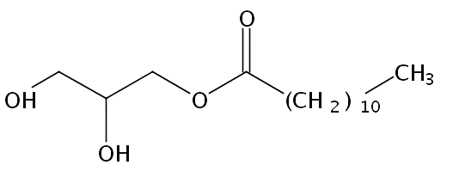
Monolaurin
Monolaurin’s proponents take it as natural alternative to antibiotics and antiviral medications for treating diseases ranging from influenza and Lyme disease to herpes.
It also softens, soothes, and moisturizes our skin.
Treats infections that can occur in skin damaged by eczema, dermatitis, psoriasis, herpes, wounds, cuts, grazes, insect bites, minor burns etc.
A skin friendly.

Slide 13
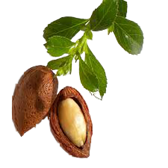
Jojoba Oil
Long used by Native Americans for its many benefits, Jojoba Oil is produced from the seed of the Jojoba plant, a shrubby tree that is native to southern Arizona and California.
Deeply-Hydrating. It is lighter than other face oils and easily absorbed into skin. It deeply penetrates to soothe and soften while providing an excellent moisturizing effect and adding a healthy glow.
Long-Lasting Moisturization. It doesn’t evaporate like water-based moisturizers, which is very important when your skin is exposed to the environment. Studies have shown that jojoba oil provides a substantial long-acting layer of moisture.
Nutritious for Skin. Jojoba is full of nutrients like Vitamin E and B, as well as antioxidants and minerals like chromium, copper, and zinc, which all nourish and protect skin. Organic, cold-pressed, jojoba oil has the highest level of antioxidants and nutrients.

Slide 14
Anti–Aging. Because it is the perfect moisturizer, Jojoba can help slow down the appearance of aging, and help to fade fine lines and wrinkles. In dermatological tests, it was shown that jojoba oil increases the skin's suppleness and the effect was still present as time passed. Tests also showed continued use of Jojoba oil resulted in reducing superficial facial lines.
Non-Acnegenic. Because Jojoba oil is very similar to human skin oils, its use can trick the skin into thinking it has produced enough oil and thus balance oil production, without promoting acne or other skin problems. Jojoba also naturally deters microbes, helping to prevent the growth of bacteria on skin.
Easy, Not Greasy. Because Jojoba oil is very similar to our own skin oils, it immediately penetrates skin and smoothes easily, helping to promote healthy, glowing skin without clogging pores or leaving a greasy residue.
Soothes Sunburn. Jojoba oils hydrating action soothes sunburn and helps reduce the chances of peeling.
Gentle & Non-Allergenic. Jojoba oil is recommended for people with sensitive skin (including psoriasis and eczema) because of its gentle nature. Applying Jojoba oil to compromised skin can help reduce flare-ups.

Slide 15

Soothes Dry Skin. Jojoba oil has anti-inflammatory properties which help to tame chaffing and chapping, reduce redness caused by drying, ease the effects of eczema and rosacea, and keep skin calm and comfortable. The Vitamin E and B-complex vitamins in the Jojoba oil help in skin repair and damage control.
Anti–Microbial. Jojoba oil naturally deters microbes, helping to prevent the growth of bacteria on skin. This property makes it useful for those with acne, and also provides an added wound-healing benefit. Bonus: Jojoba oil acts as a natural preservative.

Slide 16
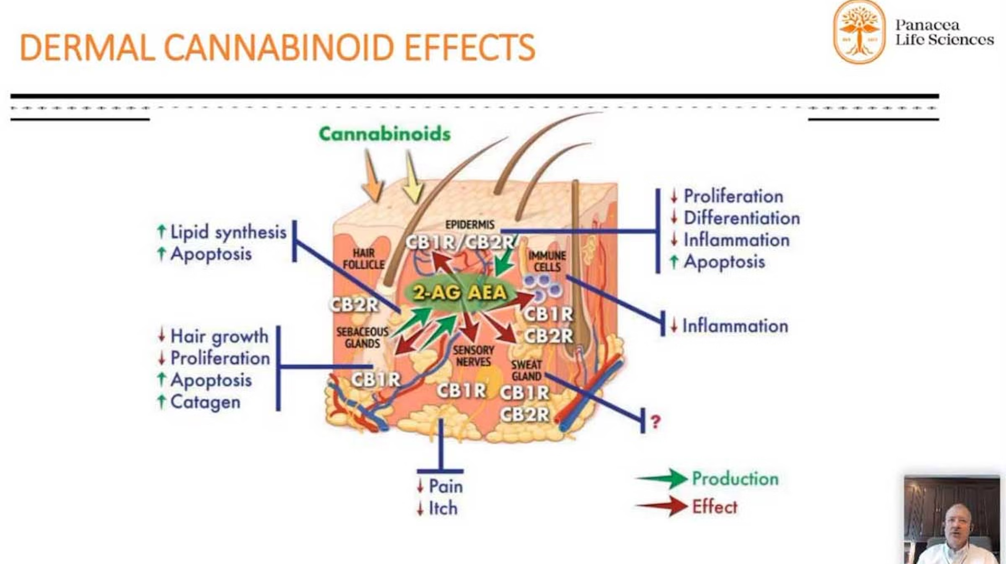

CBD
While research into CBD is ongoing, what we do know so far seems to back this up. Here’s how the antioxidant and anti-inflammatory benefits of CBD affect the body’s largest organ:

Slide 17
Exclusively, the company has developed a method to create a colloidal suspension of CBD, an innovative method that increases the bioavailability of the substance.
The method in the attached video.
The other advantages of the material are as follows:
Regulates oil production. The overproduction of sebum is thought to be a contributing factor of acne. According to a 2014 studyTrusted Source, CBD may have an anti-inflammatory effect on sebocytes, the skin cells that produce sebum.
Helps reduce inflammation. As an anti-inflammatory, CBD may be able to help reduce swelling, pain, and redness from existing breakouts, or irritation from skin conditions like eczema and psoriasis.
Hydrates dry skin. Research from 2009Trusted Source suggests that CBD may be effective for dry, dehydrated skin.

Slide 18
One of the problems with the use of CBD is the problem of bioavailability, therefore many companies use emulsifiers to turn the material into micelles to make the material an emulsion with improved absorbency.
The main problem with this method is the short-term stability of the micelles, in a short time, the material is separated into different phases.
Our method is to create a CBD solution, which upon contact with water disperses into separated molecules, thereby creating a stable colloidal suspension with maximum surface area for optimal absorption.
This technology can be used in any product containing CBD or any cannabinoid in fact.
The products in which CBD can be combined with this technology: mineral water, juices, cosmetic preparations, snacks, edible gels and practically any food product.

Slide 19


Slide 20
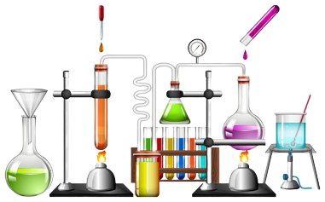
Science in Cosmetic
The cream contains a liposomal mechanisms for sustained release of the active ingredients.
Which makes the cream work for you, long time after application, in order to achieve the best results.

Slide 21
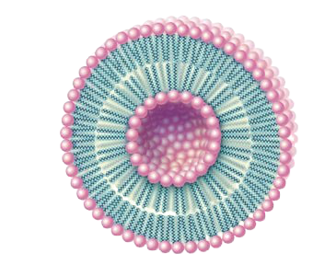
liposomal Sustained release mechanism
the center of the liposome contains the hydrophilic active ingredient which are "imprisoned" by the heads of the amphipathic ingredient that create the inner membrane, located in the center, with the hydrophobic tails facing outward, to the watery medium.
liposome

Slide 22

Hydrophilic head
Aqueous
solution
Active ingredient
Hydrophobic tail

Slide 23
Thank you for watching this presentation
(Crème de Eco)

