Slide 1


Feb. 2023
Eco R&D.
Innovation in pest control technologies
“Creativity is seeing what everyone else has seen, and thinking what no one else has thought.”
Albert Einstein

Slide 2
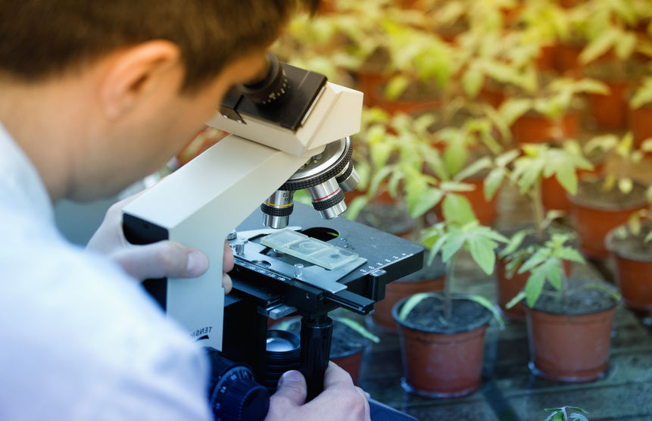
About Us
Who We Are
Eco R&D was founded in 2020 in order to develop an innovative approach to meet the growing demand for safe, environmentally friendly and effective pest control products.
As of today, Eco R&D had developed a line of agricultural products designated for the control of wide range of plant and animal pests.
Owned by Mr. Ido Eco Ofek

Slide 3
About Us
Company Roles Topics:
Mr. Iddo Ofek, Chief scientist - M.Sc. in Animal Sciences, B.Sc. in Plant Protection, M.B.A, Masters of Business Administration. 25 years of experience in developing new pesticides, cosmetic products, food additives, medicine and more.
Prof. Samir Mabjish, Advisor - Associate Professor at the Hebrew University of Jerusalem, Animal Sciences.

Slide 4
Innovation Principles
To avoid the use of poison chemicals.
All our pest control products have a low toxicological profile
To use chemical mechanisms to kill insects by exploiting a weakness in their physiological structure
To combine several pest-killing mechanisms into one product
4

Slide 5

Our Product
5

Slide 6
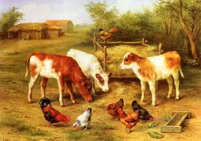
Our Product
Veterinary
Pesticides
A veterinary
Pest
Solutions
6

Slide 7
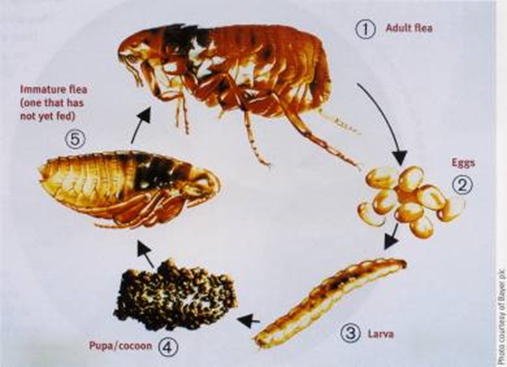
Freyja®
Freyja®
Veterinary
Pesticides
Pest Control and Disinfection Powder for use in livestock and poultry living areas and surfaces (in the absence of the animals).
Approved for use for the control of: fleas, ticks, mites, flies and microorganisms such as bacteria and fungus.
A mixture of natural mineral salts, surfactants and organic acids.
Highly hygroscopic, activated by moisture from the surrounding environment.
Releases organic acid and mineral acid solution: kills pathogens, insects, mites, nematodes.
Product Status: About to be registered in Israel by the Veterinary Services of the Ministry of Agriculture.
Fleas have a loose relationship with the host, making them hard to treat.
The surrounding environment needs to be treated to achieve complete control.
7

Slide 8
Freyja®
Freyja®
Veterinary
Pesticides
Mode of Action:
Prevents the energy creation process of Arthropods and
by blockage of the NAD co-enzyme and inter.
Death of the target is achieved within short period.
Application Instructions:
Control of fleas, flies and ticks in mammal animal pads: disperse 300 Gr./10 M² Freyja on the pad.
Control of mites in chicken pads: Spray 15% Freyja solution, 15L solution/100 M² on the pad.
Sterilization: Spray 5% Freyja solution, 100L solution for 1,000 M², spray all building parts.
8

Slide 9
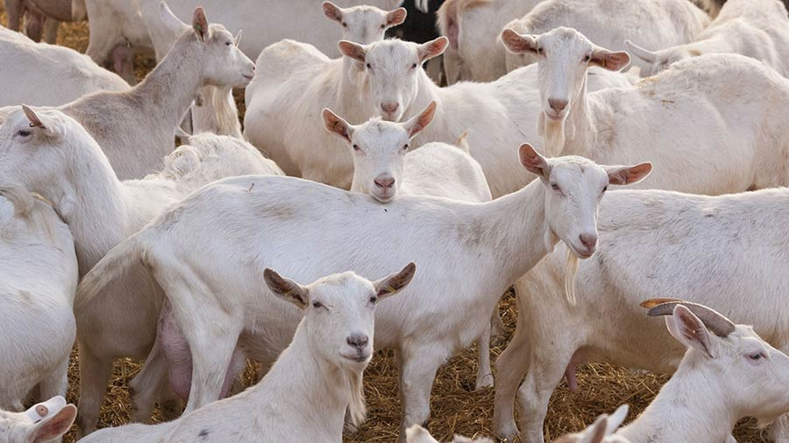
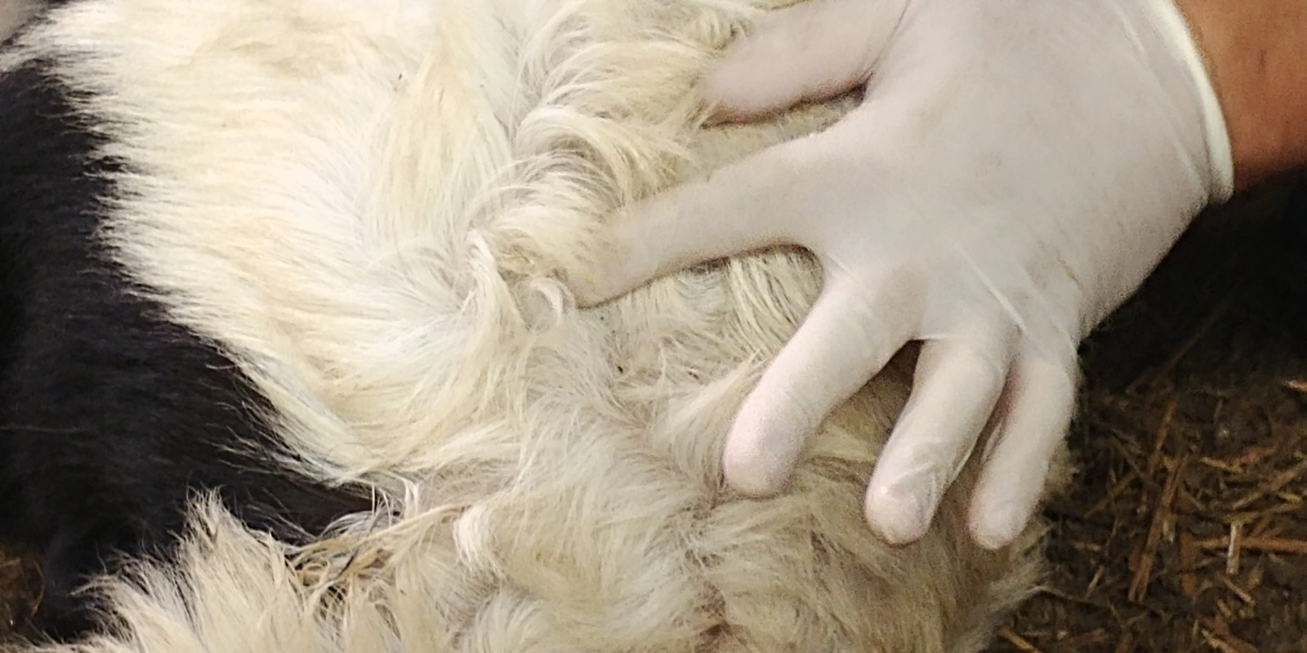
Freyja®
Control of livestock pests at
The Faculty of Agriculture in Rehovot
Veterinary
Pesticides
Efficacy test conducted in collaboration with Prof. Sameer Mabjeesh of the Hebrew University, Rehovot.
After repeated failures to end flea infestation in goat pens by using commercial pesticides, Freyja was applied.
The results were above expectations: not only did the fleas completely disappeared within two weeks, but goat mortality and diseases declined drastically, and milk yield increased.
9

Slide 10
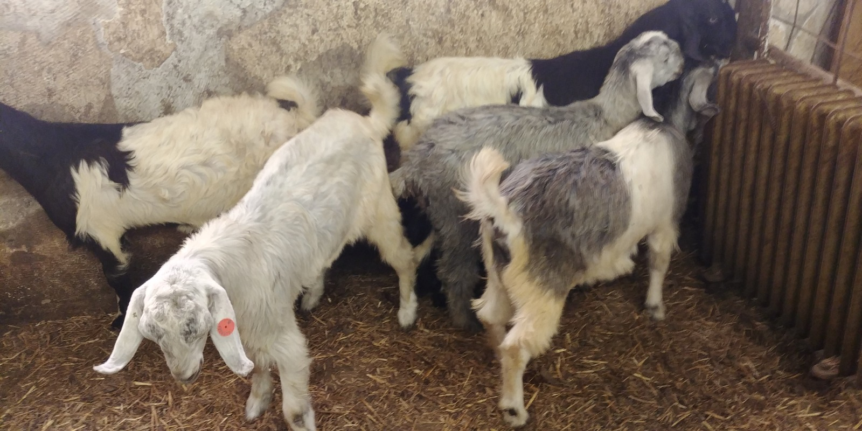
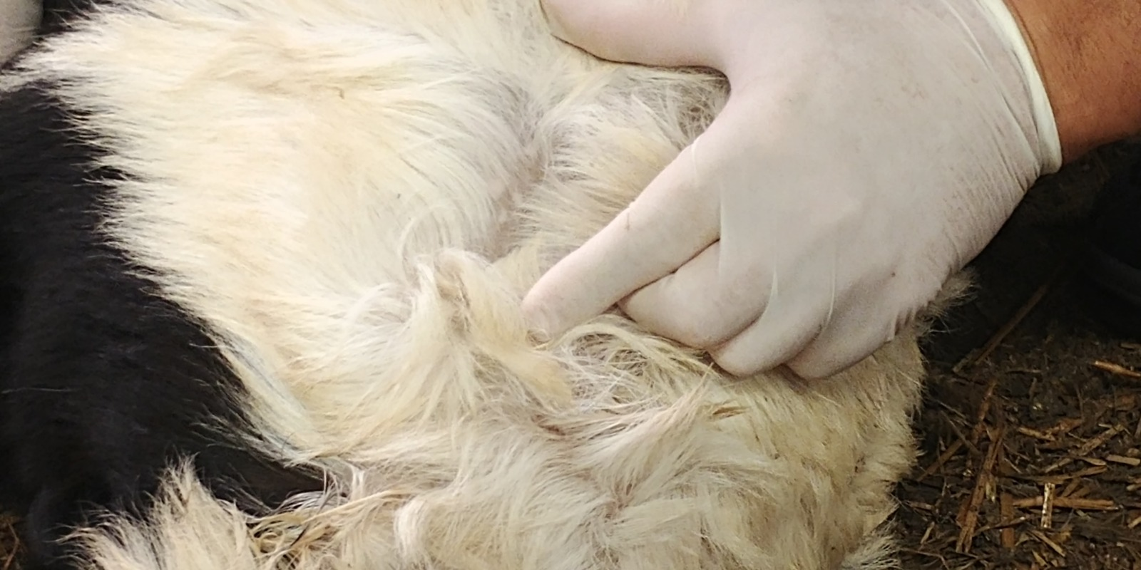
Freyja®
Control of livestock pests -
Faculty of Agriculture in Rehovot.
9.10.2020
Veterinary
Pesticides
Prof. Sameer J. Mabjeesh- PhD and DVM.
Rate: 50 Gr. Of Freyja per M², scattered on pan’s ped.
Each treatment contained 13 goats.
4 flea counts were done at: 9.10.20, 16,10.20, 23.10.20
and 31.10.20 in ped samples and on the goats body.
10

Slide 11
Freyja®
Veterinary
Pesticides
Qualitative test
Presence of any flea stages in 5 Gr. of pad samples from the pens.
Sample 1
Sample 4
Sample 3
Sample 2
Sample 5
11

Slide 12
Freyja®
Results (qualitative):
Presence of any flea stages in the pen pad (in the vicinity of the goat's habitat)
Veterinary
Pesticides
Treated pen (50 Gr/M2)
Control
Presence of Fleas |  |  |  | Sample No
31.10.20 | 23.10.20 | 16.10.20 | 9.10.20
- | + | + | + | 1
- | - | + | + | 2
- | - | - | - | 3
- | + | + | + | 4
- | - | + | + | 5
Presence of Fleas |  |  |  | Sample No
31.10.20 | 23.10.20 | 16.10.20 | 9.10.20
+ | + | + | + | 1
+ | + | + | + | 2
+ | - | - | - | 3
+ | + | + | + | 4
+ | + | + | + | 5
12

Slide 13
Freyja®
Veterinary
Pesticides
Quantitative Test
Number of fleas on a square area of 10 cm² on the back of the goat, 5 cm from the base of the tail
13

Slide 14
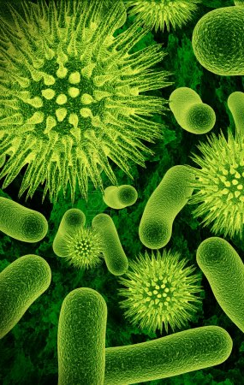
Freyja®
Disinfection Trial –
Aminolab laboratory
Veterinary
Pesticides
Microorganism: Salmonella typhimurium, Bacillus cereus and Listeria monocytogenes.
Initial solution containing 10⁶ – 10⁸ CFU/ml was prepared for each of microorganism.
0.1 ml of each solution was spread on 5X5 cm ceramic and stainless steel test coupons and left to dry for 30 minutes.
After drying, the coupons were sprayed with 10% and 5% Freyja solution and left for 8 minutes, then washed with 100 ml saline.
The eluents were filtered and the membranes were placed for incubation of 2 days in 37^{O}C.
The number of survived microorganisms from treated and not treated coupons was calculated.
14

Slide 15
Freyja®
Disinfection Trial – Aminolab laboratory
Results
Ceramics:
Veterinary
Pesticides
Control 2 | Control 1 | 1:20 | 1:20 | 1:20 | 1:10 | 1:10 | 1:10 | Microorganism
2.4 X 10⁷ | 2.7 X 10⁷ | < 1 | < 1 | < 1 | < 1 | < 1 | < 1 | Salmonella typhimurium
3.6 X 10⁵ | 3.5 X 10⁵ | < 1 | < 1 | < 1 | < 1 | < 1 | < 1 | Bacillus cereus
2.6 X 10⁷ | 2.5 X 10⁷ | < 1 | < 1 | < 1 | < 1 | < 1 | < 1 | Listeria monocytogenes
Stainless Steel:
Control 2 | Control 1 | 1:20 | 1:20 | 1:20 | 1:10 | 1:10 | 1:10 | Microorganism
1.8 X 10⁷ | 1.8 X 10⁷ | < 1 | < 1 | < 1 | < 1 | < 1 | < 1 | Salmonella typhimurium
3.3 X 10⁵ | 4.3 X 10⁵ | < 1 | < 1 | < 1 | < 1 | < 1 | < 1 | Bacillus cereus
2.6 X 10⁵ | 2.6 X 10⁵ | < 1 | < 1 | < 1 | < 1 | < 1 | < 1 | Listeria monocytogenes
15

Slide 16
Veterinary
Pesticides
Freyja®
Results (quantitative):
Average calculation out of 13 goats
Population Change (%) | Average number of Fleas per goat |  |  |  | Treatment
 | 31.10.20 | 23.10.20 | 16.10.20 | 9.10.20
- 97.3 | 0.7 | 4 | 14.9 | 25.5 | Freyja® 50 Gr/M2
+ 3.5 | 26.9 | 27.5 | 25.8 | 26 | Control
16

Slide 17
Freyja®
Results (quantitative):
Average calculation out of 13 goats
Veterinary
Pesticides
Population Change (%) | Average number of Fleas per goat |  |  |  | Treatment
 | 31.10.20 | 23.10.20 | 16.10.20 | 9.10.20
- 97.3 | 0.7 | 4 | 14.9 | 25.5 | Freyja® 50 Gr/M2
+ 3.5 | 26.9 | 27.5 | 25.8 | 26 | Control
17

Slide 18
Freyja®
Results (quantitative):
Average calculation out of 13 goats
Veterinary
Pesticides
18

Slide 19
Freyja®
Veterinary
Pesticides
19

Slide 20
Veterinary
Pesticides
Freyja®
Results
After Freyja treatment | Prior to Freyja treatment |  |  | Swabs
10.9.20 | 1.7.20 | 23.6.20 | 11.6.20
- | + | + | - | Floor - 1
- | - | + | + | Floor - 2
- | - | - | + | Floor - 3
- | + | - | - | Floor - 4
20

Slide 21
Our Intellectual Property
Our products are the result of our own development.
21

Slide 22
THANK YOU
For more information:
Eco R&D
22

